Slide 1
Overview slides
1 January 2025

Slide 2


Datasets
Hosted portals
110,905
25
Country Participants
64
Peer-review papers
using data
12,184
Organizational Participants
Average records
downloaded per month (2024)
43
202.8 billion
Species
occurrence records
Publishers
2,354
3,038,370,536
By the numbers | 1 January 2025
www.gbif.org

Slide 3
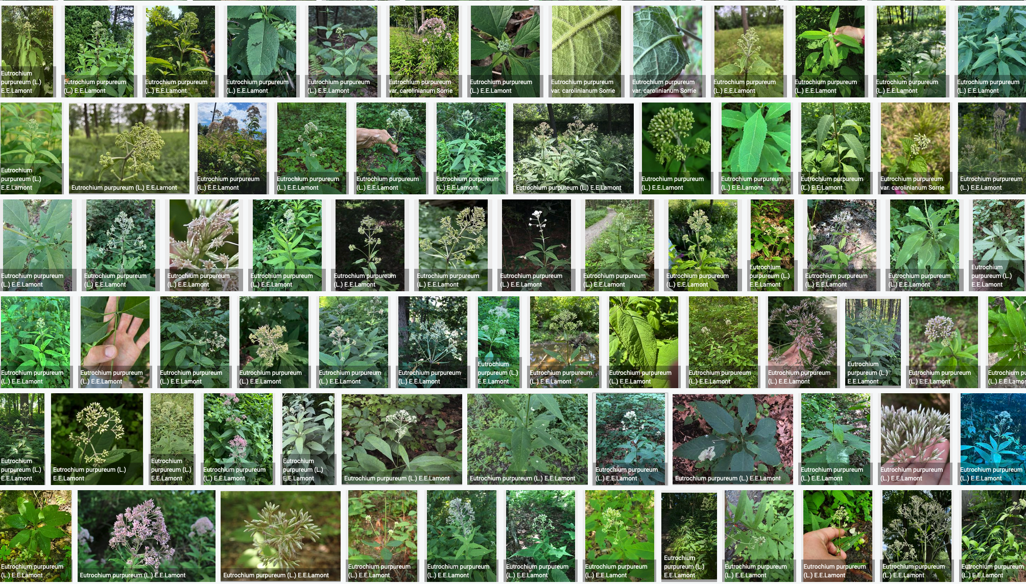
Species occurrence records with multimedia evidence
1 January 2025
213.5 million records with taxonomically identified images
139.4 million human observations
64.4 million specimens
7.1 million material samples
1.4 million fossil specimens
1,550,131 audio files
11,368 videos
https://www.gbif.org/occurrence/gallery

Slide 4
GBIF Participant countries
1 January 2025
Voting Participants
Associate Participants

Slide 5
GBIF network of data publishing institutions
1 January 2025
144
countries/areas with institutions
sharing data through GBIF
Number of active publishers by country or area

Slide 6
GBIF.org traffic by country: 2024
1 January 2025
Rank | Country/Territory | Visitors | Visits | Effective visits* | % Effective visits | 2023 rank | Pages / visit
1 | United States | 1,030,699 | 1,162,596 | 441,786 | 9.85 % | 1 | 3.63
2 | Colombia | 425,449 | 543,746 | 250,123 | 5.58 % | 2 | 4.40
3 | Indonesia | 330,663 | 403,168 | 225,774 | 5.03 % | 5 | 5.34
4 | Spain | 373,233 | 452,436 | 212,645 | 4.74 % | 8 | 5.14
5 | France | 492,489 | 562,823 | 208,245 | 4.64 % | 6 | 3.03
6 | Mexico | 423,137 | 494,294 | 207,603 | 4.63 % | 4 | 4.11
7 | China | 747,489 | 1,025,378 | 205,076 | 4.57 % | 7 | 4.13
8 | Brazil | 450,280 | 518,753 | 186,751 | 4.16 % | 3 | 3.94
9 | Germany | 367,523 | 436,611 | 179,011 | 3.99 % | 9 | 4.76
10 | India | 360,807 | 399,038 | 147,644 | 3.29 % | 10 | 3.34
 | TOTAL | 9,108,096 | 10,941,747 | 4,486,116 | 100.00% |  | 4.28

Slide 7
Occurrences published by country: 2024
1 January 2025
Rank | Country/Territory | 2024 | 2023 total | 2023 rank
1 | United States | 158,323,610 | 151,004,708 | 1
2 | France | 43,910,491 | 13,208,845 | 5
3 | Sweden | 25,696,307 | 9,339,841 | 7
4 | Netherlands | 25,251,786 | 14,293,849 | 4
5 | Canada | 22,530,128 | 22,744,659 | 3
6 | Australia | 14,003,238 | 12,714,959 | 6
7 | United Kingdom | 12,938,043 | 36,220,446 | 2
8 | India | 10,369,964 | 8,542,437 | 9
9 | Spain | 9,429,667 | 7,633,366 | 8
10 | Poland | 8,675,622 | 2,600,757 | 22
OTHER COUNTRIES + AREAS | OTHER COUNTRIES + AREAS | 97,322,395 | 81,266,325
TOTAL |  | 428,451,251 | 355,993,458

Slide 8
Data download requests by country: 2024
1 January 2025
Rank | Country |  | 2024 | 2023 total | 2023 rank
1 | China | 63,485 |  | 39,253 | 1
2 | United States | 41,921 |  | 34,275 | 2
3 | Mexico | 29,712 |  | 26,051 | 3
4 | Colombia | 21,641 |  | 19,341 | 4
5 | Brazil | 21,274 |  | 18,370 | 5
6 | Spain | 14,704 |  | 13,492 | 6
7 | United Kingdom | 13,502 |  | 10,044 | 7
8 | Canada Germany | 8,946 |  | 6,649 | 9
9 | France Canada | 8,872 |  | 7,248 | 8
10 | Germany France | 8,558 |  | 5,788 | 10
OTHER COUNTRIES + AREAS | ALL OTHERS | 115,002 |  | 87,262
TOTAL |  | 347,717 |  | 267,773
157
countries, islands & territories where users have ≥10 requested downloads

Slide 9
Peer-reviewed publications using GBIF-mediated data
1 January 2025

Slide 10
Data use in peer-reviewed journals: 2024
1 January 2025
Peer-reviewed uses by country
Peer-reviewed uses by region
End of Year |  |  | 2024 total | 2023 total | 2023 rank
1 | China |  | 529 | 381 | 2
2 | United States |  | 486 | 387 | 1
3 | Brazil |  | 238 | 191 | 3
4 | Mexico |  | 186 | 129 | 7
4 | United Kingdom |  | 186 | 182 | 4
6 | Germany |  | 176 | 163 | 5
7 | Spain |  | 171 | 130 | 6
8 | Italy |  | 107 | 79 | 10
9 | France |  | 105 | 108 | 8
10 | Australia |  | 104 | 94 | 9

Slide 11

Suggestions reviewed
Institutions
8,639
2,003
vv
Countries
Collections
120
8,342
Country editors
Digitized specimens
60
233,125,538
GRSciColl by the numbers | 1 January 2024
scientific-collections.gbif.org

Slide 12




Hosted portals
12
GBIF Participant and GBIF Regional
4
Institutional
25
Hosted portals in production
7
27
Networks/thematic networks
In development

Slide 14
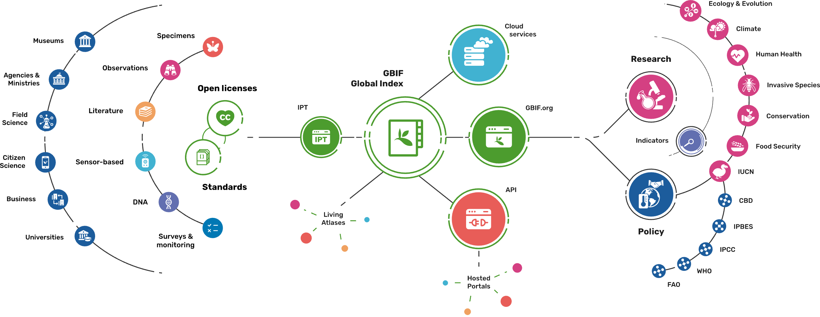
Providing biodiversity evidence for research and policy

Slide 15
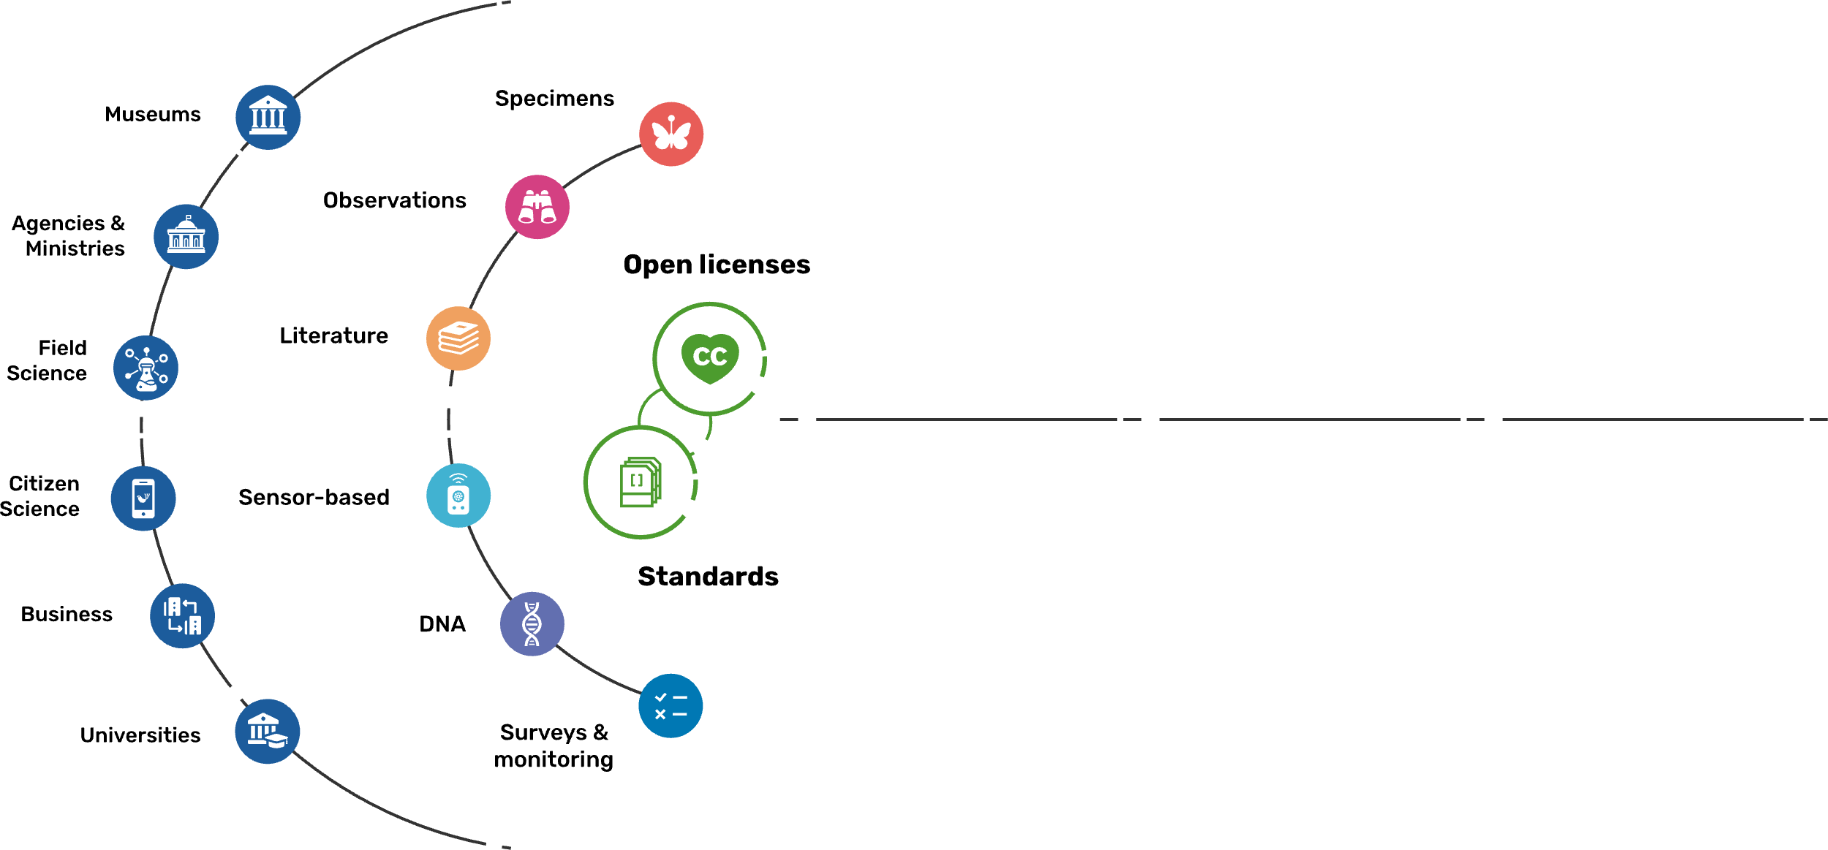
Sources of biodiversity evidence
Create
Combine sources of evidence

Slide 16
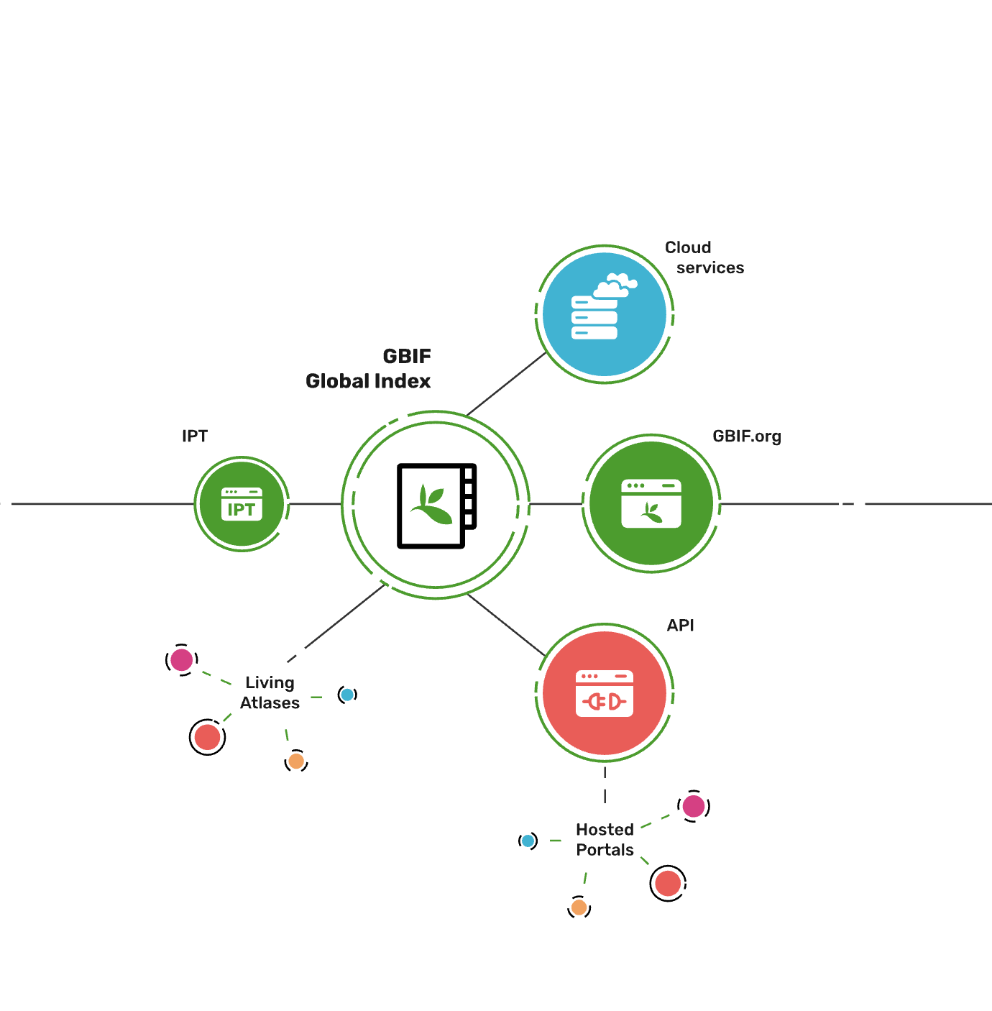
Access to biodiversity evidence
Share
FAIR and open access

Slide 17
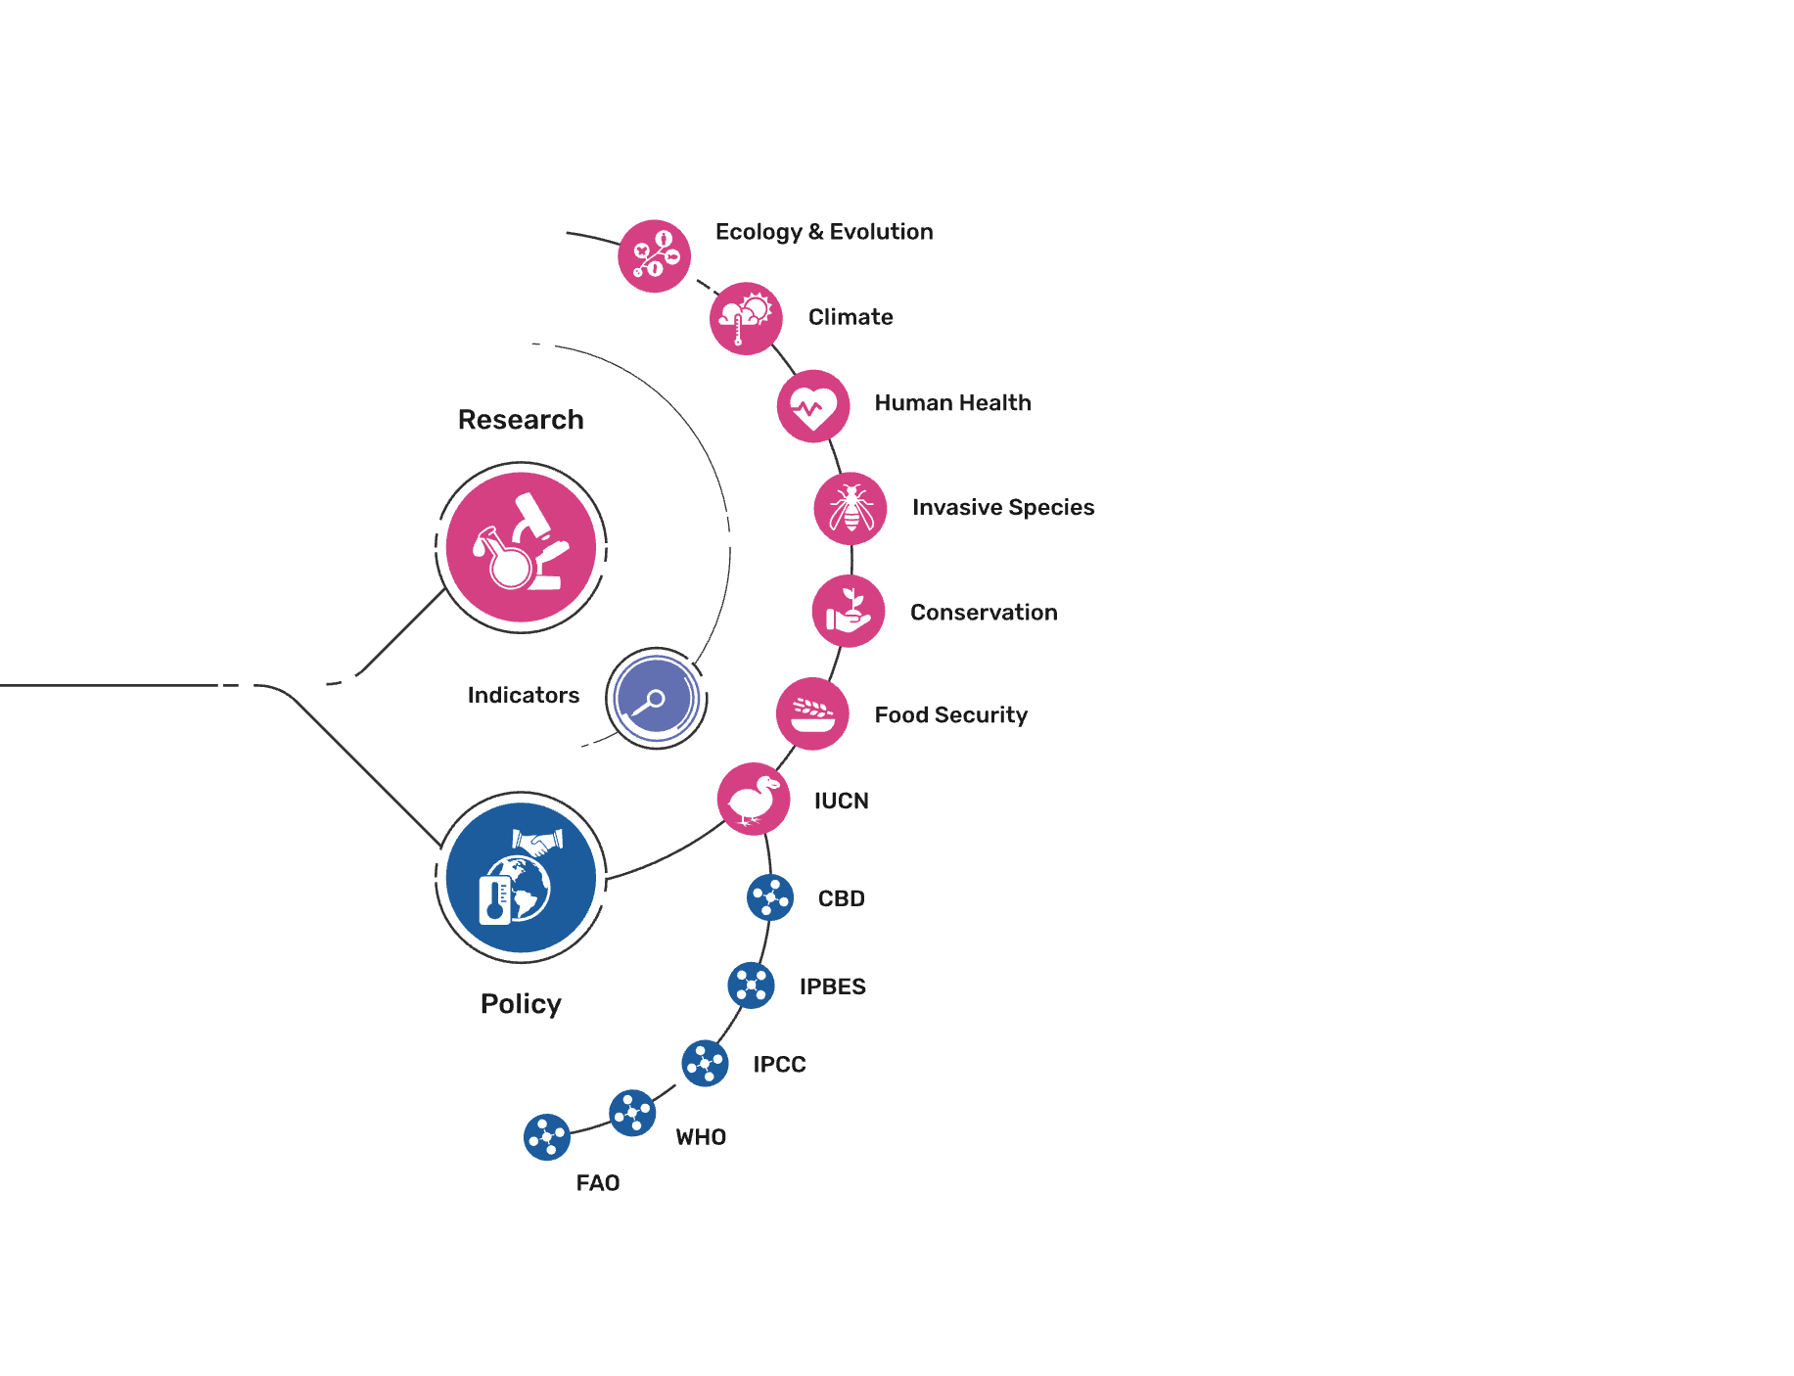
Uses of biodiversity evidence
Transform
Apply and use data

